Slide 1
Batch DEM Conversion and Re-Projection
Automation using Python
Nicholas P. Taliceo
Adapted From
GISC 6317 | Fall 2016
August 22, 2017

Slide 2
Purpose
Download large quantities of DEM files on the web.
Example: DEM data for all cities in a county.
Perform other GIS tasks associated with many DEM files that will otherwise take large amounts of time if processed manually.
Extract data from ZIP files which were downloaded.
Geoprocessing tasks
Re-projection
DEM to other raster type
Create a raster mosaic
Incorporate into a current working map
Uses Beautiful Soup (bs4) Python library for web scraping.

Slide 3
batchDEM.py
What does this script do?
Asks the user what website to parse and where to store the data (i.e., on your local drive).
Downloads all files associated with that particular webpage that are contained within ZIP files.
Extracts the files on your local drive and deletes the ZIP files.
User can choose to…
…re-project all DEM files downloaded with respect to a feature class in your map of working directory.
…change the file type of the DEMs (i.e., from .dem to Esri grid files).
…create a raster mosaic of any or all of the DEM files.
…incorporate the new raster mosaic into the current map.

Slide 4
Demonstration

Slide 5
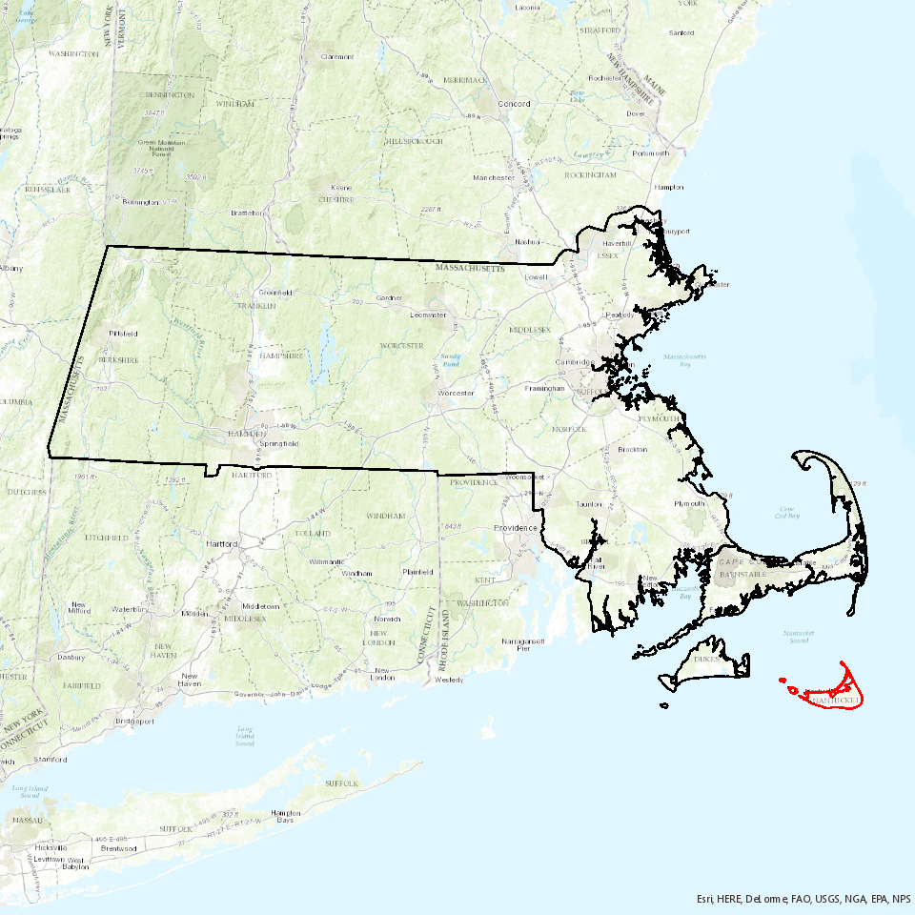
Demonstration
Nantucket County, Massachusetts

Slide 6
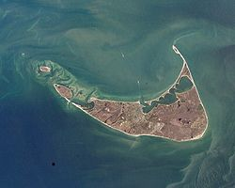

Demonstration
Python Script
batchDEM.py
Data
http://www.webgis.com/terr_pages/MA/dem75/nantucket.html

Slide 7
Summer Internship

Slide 8

My Internship
The Travelers Indemnity Co., Hartford, CT
Advanced Analytics, Personal Insurance, Research & Development (PI R&D)
Auto, property, monitoring & data, innovation
Work mostly on modeling
Additive models, trees, boosting & bagging, text mining, GLMs, deep learning, AI
SAS, R, Python
Also utilize geospatial analysis

Slide 9
Geospatial-Related Projects
Several small projects with short turn-around time
Explored telematics data collected from opted-in policy driver either with a dashboard attachment or through a smart phone app
Finding driving patterns of start/end trip locations
Main Project
Determine a way to segment 5-digit ZIP Codes based on where people drive
When someone calls Travelers for an auto insurance quote, we ask where they park their car (i.e., where they live)
Use the ZIP Code of this location to assess driver risk
If we know of a common end trip location we can find driving routes from starting locations (network analysis)
Assess driving risk by routes they drive
Segment ZIP Codes with Thiessen polygons from starting locations.
All of this was done using Python
Python 2.7 & ArcMap 10.4

